Slide 1






School Safeguarding Systems & Case Management
Uganda Context- School Sports &
Physical education
                Presentation by : Musiime Cissy Byabaraire
                Education: HONS. Bsc DEGREE IN SWASA, ICECP Graduate -XV(2024-2025), FIVB LEVEL III International COACH, INTERNATIONAL ARCHERY COACH, ASMAC 2017
                SAPS: EX-Board Member UVF (2021-2025), UOC- Secretary; Youth & Talent Identification Commission, Women’s council Cricket Uganda, Anti-Doping Educator, Safeguarding Officer
                28th Nov 2025

Slide 2
1. Understanding Safeguarding
Protecting children from harm, Vulnerable Adults, PWDs, Refugees
Preventing abuse in school sports
Ensuring safe participation for all
Legal framework: Children Act (Amended), MoES guidelines, USSA, NCS, NFs, other sports bodies, school sports rules / regulations

Slide 3

2. Disclosures
Listen, reassure, don't promise secrecy
Record exact words, (whistleblower)
Report immediately to Designated Safeguarding Officer (DSO)
Act, don’t investigate

Slide 4
3. Referral Pathways in Uganda
School DSO → Head Teacher
District Probation Officer
Police Child & Family Protection Unit (CFPU)
Health facility for medical exams (PEP, STI screening)
Local NGOs (e.g., Raising Voices, ??)

Slide 5
4. Working with Support Services
• Maintain confidentiality
• Provide psychosocial support
• Engage parents/guardians appropriately
• Follow-up on case outcomes
• Document all actions taken

Slide 6

5. Creating Safe School Sports Environments
Codes of conduct for teachers & coaches (++ASPs)
Safe changing room management (facilities)
Proper supervision relationships(meals)
Safe transport procedures
Gender-sensitive (coaching) practices
Affordable communication Suggestion box, Notice boards, SG placards, signposts
Bonding activities out of sports/ awards
Art & drama

Slide 7
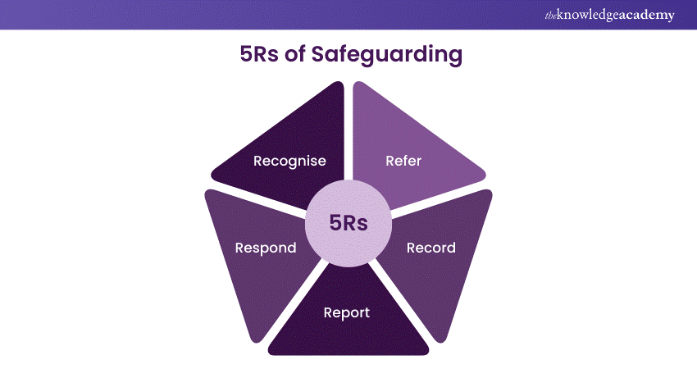
6. Reporting & Case Management
Immediate documentation
Incident reporting form
Case logbook
Confidential file storage
Follow-up & action updates
5Rs

Slide 8
7. Key Responsibilities of Teachers/Coaches
KEY ASPECTS
1. Adherence to rules, policies & codes of conduct
2. Clean sport & anti-doping obligations
3. Respect & sportsmanship
4. Commitment & discipline (compliance)
5. Communication & cooperation with (SPs)coaches, medical staff, teammates, police, legal, cleaners, cooks, askaris
6. Role in governance & advocacy (if applicable)
Duty of care
Positive role modelling
Preventing abuse
Upholding safety policies
Reporting concerns early
SACs: Additional trainings in sport of speciality

Slide 9

8. Implementation plan
Enforce Olympic values
Advocate
Investment (giveback)
Sensitize, safeguarding toolkits (IOC to IFs +NOCs)
Enforce systems in our schools settings
compliance = use media, funding, licencing, contracts
Monitoring + Evaluation (feedback)
Promote ethical conduct & accountability in sports governance
Partnerships (community engagement)
Ensure schools run safeguarding committees of trained skilled Safeguarding officers

Slide 10
9. Conclusion:
1> Perseverance to team up, the future impact of Safeguarding in sports in schools will be transformative.
2> Combining expertise with school setups/local knowledge, these partnerships will create:
    Strong grassroots systems
    Inclusive & safe sport environments
    Sustainable development pathways
    Healthier and more active societies/ communities
    Core values of Olympic movement
3> Safeguarding in sports in schools is no longer just a concept—it is becoming a collective global movement with real, measurable impact.

Slide 11



Safeguarding is mutual and everyone’s responsibility

