Slide 1

SPORT SAFEGUARDING
ESSENTIALS
INNOPHINE, ENTEBBE
NOVEMBER 28, 2025
By Ms. PATRICIA AYEBARE

Slide 2

HOUSE KEEPING RULES
Keep Phones in silence / Turn Off
NO Chewing Gum / anything
Confidentiality is PARAMOUNT
All contributions are welcome
Questions are encouraged

Slide 3
CONTENT
Misconceptions
Definition
Roles and Responsibilities
Principles of safeguarding
Reporting mechanisms

Slide 4
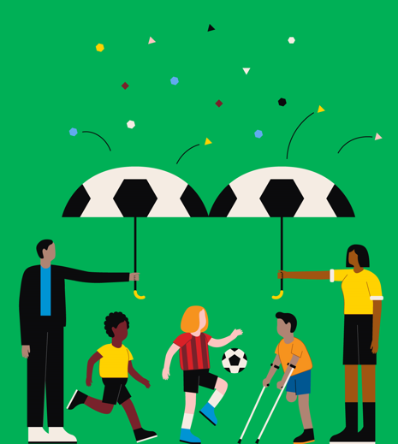
WHO IS THIS PROGRAM FOR?
This program is designed for everyone from grassroots to the elite or the Professionalism
This course explains how safeguarding is everybody’s responsibility.
As a committee member, a delegate, Club owner, manager,coach you have a part to play in keeping children, athletes and other officals safe in football

Slide 5

WHO IS THIS PROGRAM FOR?
Athletes or players,
Coaches
Managers or Administrators,
Club Owners
Officials
Safeguarding or child protection lead
physiotherapist or medic
Parents
Human resources
Volunteers
Management team and Board Members etc

Slide 6
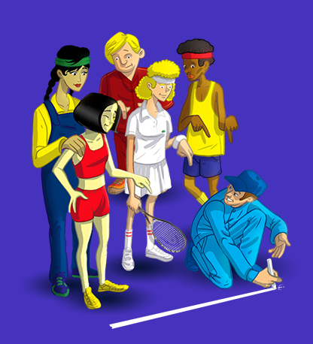
DRAW THE LINE

Slide 7
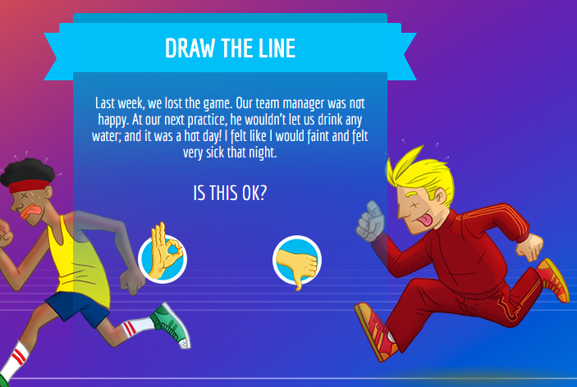

Slide 8
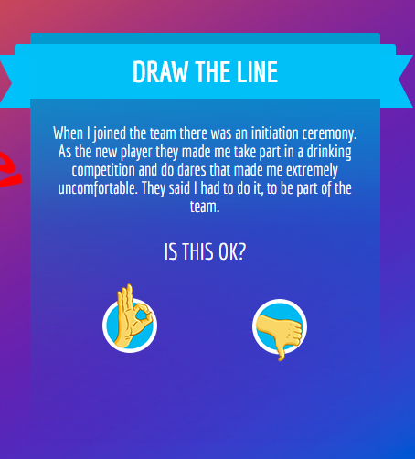

Slide 9
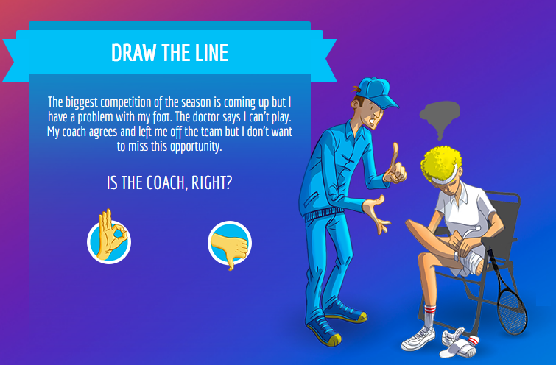

Slide 10
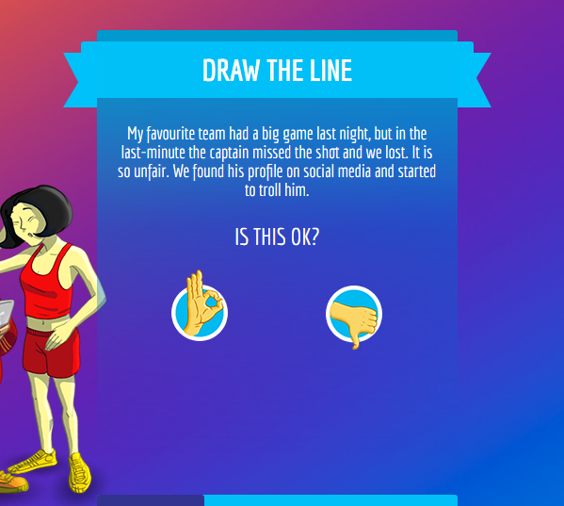

Slide 11
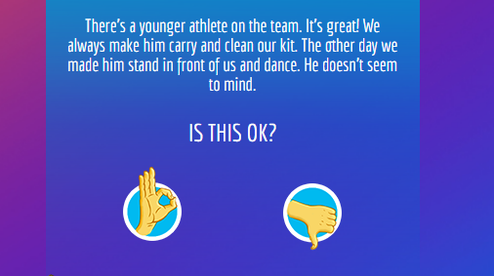

Slide 12
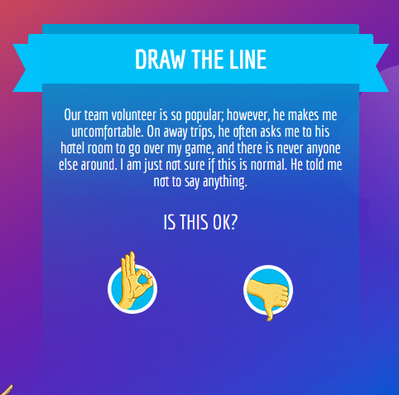

Slide 13
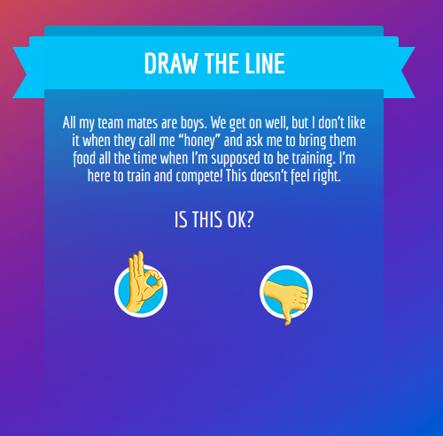

Slide 14
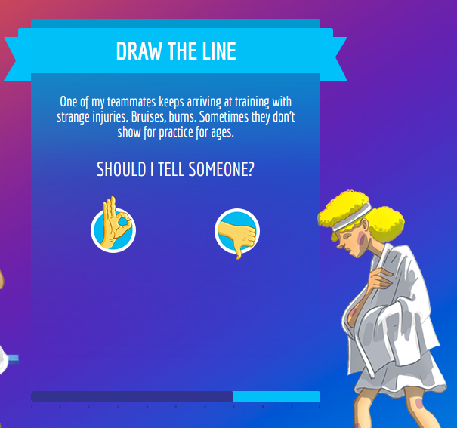

Slide 15
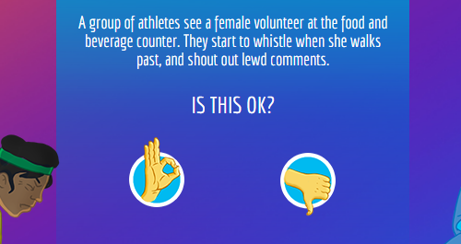

Slide 16

COMMON MISCONCEPTIONS
Safeguarding Only Applies to Children
It's Only About Sexual Abuse
Abuse Doesn't Happen in "My" Sport/Club
Safeguarding Hinders Performance
Policies and Forms are Enough
Safeguarding is Only the Responsibility of the Welfare Officer

Slide 17
COMMON MISCONCEPTIONS
Physical Contact is Always Forbidden
“Harassment and abuse only happen in certain countries.”
“It’s a woman ’s-only problem”
“The demand to win comes at a high cost.”
“This is just how it is”

Slide 18


Slide 19
‘Safeguarding’ is sometimes used as an umbrella word but what does it include?
You may have heard ‘child protection’ used before
Safeguarding and child protection are closely linked but they mean different things

Slide 20

WHAT IS SAFEGUARDING

Slide 21
SAFEGUARDING
Safeguarding is about creating safe environments and preventing children and vulnerable adults from experiencing harm or abuse.
CHILD PROTECTION
UNICEF defines it as ensuring that every child has the right to live free from violence, exploitation and abuse
Child protection refers to the safeguarding of children from violence, exploitation, abuse, abandonment, and neglect

Slide 22
DEFINITION OF SAFEGUARDING
This is the TAKING OF PROACTIVE ACTIONS to PROMOTE the well-being of children (U-18) vulnerable adults, and adults by keeping them safe from harm and abuse.
(protecting of children, vulnerable adults and adults)
It means doing everything possible to prevent any kind of harm or abuse from happening.

Slide 23


MAINLY FOCUSES ON
The things we do to minimize risk.
It means doing everything possible to prevent any kind of harm or abuse from happening such as physical, sexual, emotional abuse and neglect, grooming, trafficking and exploitation
The things we need to do when we’re concerned that someone is at risk or suffering harm or abuse

Slide 24

Who is responsible for providing safe sport environments? Everyone in sport has a duty to make sure activities are delivered as safely as possible. This is part of our safeguarding responsibility

Slide 25

WHO IS A SAFEGUARDING OFFICER
A safeguarding officer is a person who manages safeguarding concerns and protects children, athletes, officials or team entourage from abuse and harm
They are the FIRST point of CONTACT for issues related to abuse, poor practice

Slide 26

ROLES OF A SAFEGUARDING OFFICER
To implement safeguarding policies and procedures
To report any concerns or incidents
To provide support and guidance to players, staff and officials
To collaborate with Union/Federation/Association/Club in making sure there is compliance
Creating more awareness about safeguarding

Slide 27
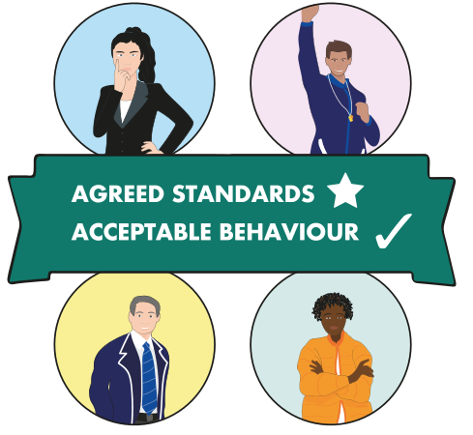
PRINCIPLES OF SAFEGUARDING
TO always act in the best interests of children and everyone involved in sports
To respect and promote everyone’s rights throughout sport
To apply all the principles and practices in the safeguarding toolkits without discrimination of any kind
To ensure safeguiarding for everyone in sports

Slide 28
PRINCIPLES OF SAFEGUARDING
To ensure safeguarding for children and everyone in sports is everyone’s responsibility, regardless of the country we are from or the role we hold in sports
To ensure roles and responsibilities are defined within our sports federations or Associations

Slide 29
Watch this video which shows a grassroots tennis club and one of the players, Felipe. As you watch the video, think about whether Felipe has been harmed or abused?

Slide 30


Slide 31
Yes, Felipe has been harmed and abused.
Both aggressive language and being hit can cause emotional harm.
Hitting someone is considered physical harm, even if no marks are visible.
These are examples of poor coaching practice and are a form of abuse.
Felipe will probably remember being humiliated in front of others forever

Slide 32
Everyone has the right to play and serve sport in a safe and supportive environment, especially children (mass), elite and Pro athletes and the vulnerable adults

Slide 33
What is safeguarding about?
Safeguarding is about the things we can do to prevent Felipe’s coach behaving like he does, and the way we respond if we find out an athlete or player like Felipe is at risk of harm
Safeguarding includes much more than just addressing poor practice.

Slide 34
WHAT ARE WE SAFEGUARDING FROM?

Slide 35
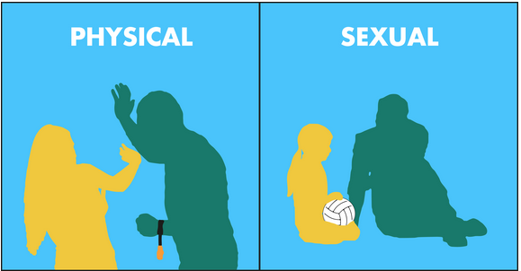
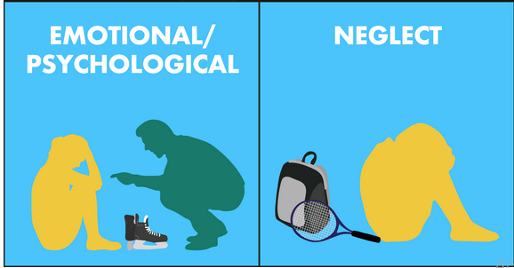
THE FOUR MAIN FORMS OF VIOLENT ACTS

Slide 36




Definitions
Physical abuse
Physical harm, trauma or injury.
Sexual abuse
Any conduct of a sexual nature, whether non-contact, contact or penetrative, where consent is coerced/manipulated
or is not or cannot be given (as is the case with children).
Psychological abuse
Deliberate,
repeated, non-contact
behaviour within a power
differentiated relationship
Neglect
Repeated failure to meet a person’s physical and emotional needs or to protect them from exposure to danger.
Harassment
Any unwanted physical or verbal behaviour aimed at offending or humiliating someone.

Slide 37
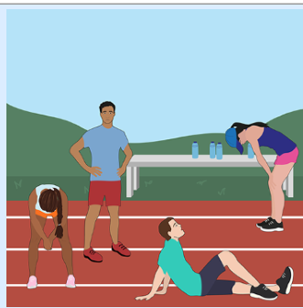
PHYSICAL
Forcing athletes to run several times round the track when they haven’t done something the coach asked them to do and punishment by exhaustion for forgetting their kit

Slide 38
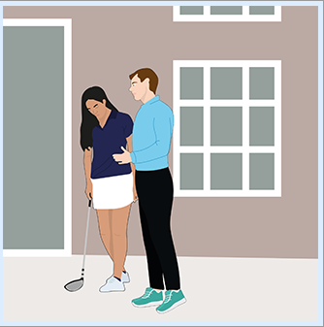
SEXUAL
A 16-year-old golfer was asked by the golf professional at her club to caddy for him in a local tournament.
Everything went well on the course, but when the professional dropped her home, he asked her for a kiss.
She did not know what to do, so she gave him a peck on the cheek, to which he responded that he wanted a real kiss

Slide 39
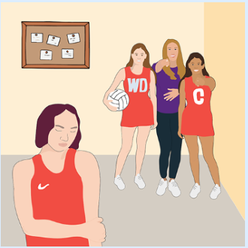
EMOTIONAL/PSYCHOLOGICAL
A women’s netball team includes several gender non-binary players.
The coach frequently makes comments saying "are you a boy?" and labels their haircut a ‘boycut’.

Slide 40
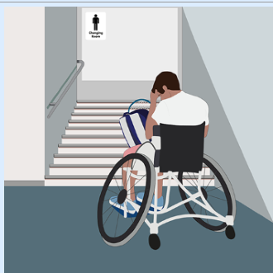
NEGLECT
A wheelchair user was invited to participate in a tennis competition.
There was no accessible changing room and toilet facilities at the venue.
Upon raising this, the wheelchair user is told to "stop complaining and adapt".

Slide 41
OTHER FORMS OF HARM & ABUSE

Slide 42
BULLYING
Bullying is often found to be the number one concern for children
It is a form of emotional/psychological abuse
It’s not just an issue for children
It also affects many adults in sport.

Slide 43
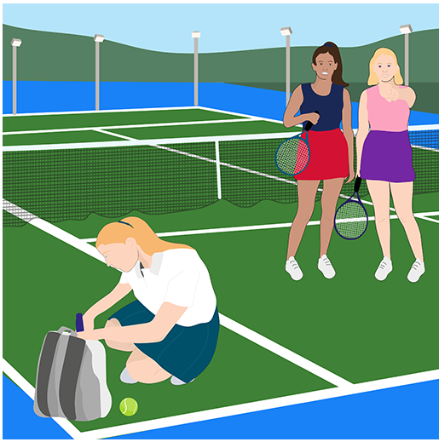
Bullying can have long-term effects and can happen wherever people get together – including within sport.
It’s sometimes assumed that bullying between children is less serious than abuse by adults – but this is not necessarily true.
Bullying behaviour always requires a response.
The impact of bullying can last a lifetime – it’s always important to act.

Slide 44
BULLYING TAKES MANY FORMS
S/N | FORM | EXAMPLES
1 | Physical | hitting, pushing, kicking or other physical assaults; intimidating; taking or damaging belongings.
2 | Verbal | offensive name-calling, insults or gossiping, spreading nasty rumours, constantly undermining someone.
3 | Non-verbal | using offensive hand gestures or signs; excluding, ignoring or ‘blanking’ someone
4 | Racist, sexist or homophobic | racist remarks, sexist comments, or homophobic, transphobic or gender-related comments
5 | Sexual | sexualised name-calling, comments, or threats; inappropriate and uninvited touching; inappropriate sexual propositions.
6 | Online | use of social media or text messages to make comments, send threats, and spread rumours and allegations.

Slide 45
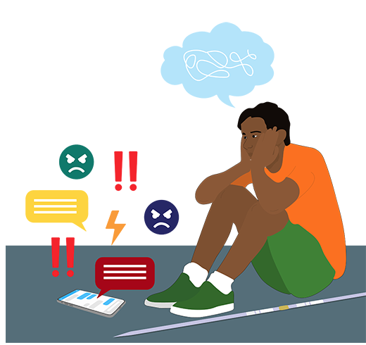
DIGITAL BULLYING & HARRESEMENT

Slide 46
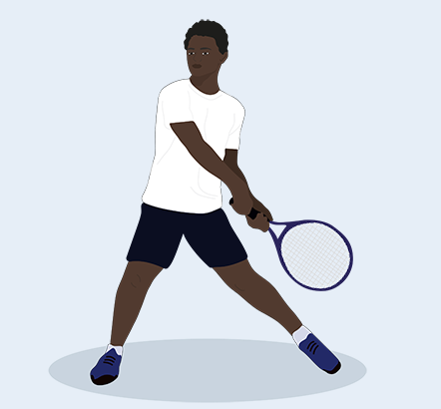

Listen from Ryan and try to list all the different ways that using digital technologies made it easier for David to bully Ryan.
As you listen, also think about how you might tackle this kind of bullying in your organization.

Slide 47
ADDRESSING DIGITAL BULLYING
Tackling online bullying & harrasement is an important part of our organisation’s DUTY
Just because something happens in the VIRTUAL WORLD and not during a sporting activity, doesn’t make it any less of an organisation’s responsibility, or any less harmful.

Slide 48
ADDRESSING DIGITAL BULLYING
In the case of Ryan, the online bullying was only addressed when the Safeguarding Lead heard about it from a coach and took action with those involved.

Slide 49
EXPLOITATION
This form of abuse cuts across all the above areas.
Exploitation is the act of ABUSING power over someone and/or their assets for personal gain.

Slide 50
EXAMPLES IN SPORT INCLUDE:
Sexual exploitation and trafficking.
Financial exploitation through taking an unfair share of sponsorship or other funding earned by an athlete.
Misrepresenting an athlete’s age or nationality.
Signing athletes up to long-term contracts that don’t benefit them – especially when they are still children.

Slide 51

THE NEW CONCEPT OF GROOMING
It involves SLOWLY GAINING THE TRUST OF A POTENTIAL VICTIM before systematically breaking down interpersonal barrier prior to committing sexual abuse.
The process can take weeks, months or years with the perpetrator usually moving steadily so that he/she is able to maintain secrecy and avoid discovery.

Slide 52

GROOMING
The young athletes can become trapped, because his or her compliance is assured by using threats such as being cut from the team and/or giving or withholding privileges
Important because it brings about the appearance of cooperation from the athlete, making the act of abuse seem to be consensual

Slide 53
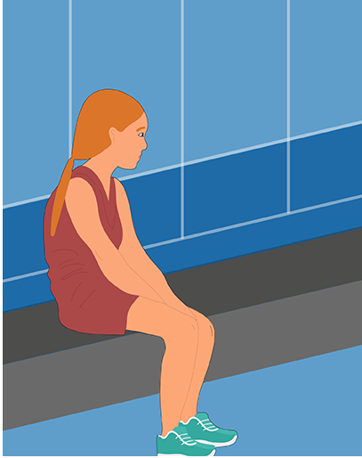
A MODEL OF THE GROOMING PROCESS
Stage 1: Targeting the victim
Stage 2: Gaining trust
Stage 3: Meeting a victim’s need
Stage 4: Isolating the victim
Stage 5: Sexualising the relationship
Stage 6: Maintaining control and secrecy
Model by (Hartill, 2018):

Slide 54
A groomer wants AN IMAGE AND REPUTATION that means anyone hearing any allegation will react with disbelief. This is one way that groomers try to make sure they are not stopped from abusing and is all part of the manipulative way that they operate.

Slide 55
If more people understand these different types of abuse, it contributes to a safer environment and safeguarding concerns are more likely to be identified.

Slide 56

WHAT RISKS CAN YOU IDENTIFY AND HOW MIGHT THESE HARM THE ATHLETES OR PLAYERS?

Slide 57
WHO ARE THESE VULUNERABLE PEOPLE

Slide 58
SOME PEOPLE ARE MORE VULNERABLE TO ABUSE?
Research shows that some groups are significantly more vulnerable to abuse than others
Anyone CAN experience abuse – this is why organisations need policies and procedures to protect everyone.
‘Vulnerable’ refers to anyone in a position that means they are more EXPOSED to the possibility of being abused.
Vulnerable people need particular support and protection to reduce the risk of abuse.

Slide 59
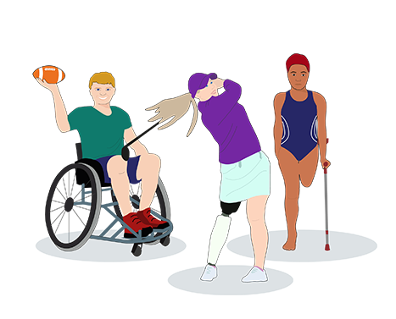
1. PEOPLE WITH DISABILITY
Disability’ is used to cover a range of health conditions and impairments.
Some conditions are visible and obvious (e.g. people who use a wheelchair) while others are non-visible (e.g. people with autism).

Slide 60
THE DIFFERENT CONDITIONS CAN BE GROUPED INTO SEVERAL BROAD CATEGORIES:
Physical
Sensory - (hear or see clearly)
Intellectual - (learning difficulties or learning disabilities)
Interaction and communication difficulties - Autistic Spectrum Disorder,
A combination –cerebral palsy may have both a physical impairment which impacts on their mobility as well as speech and language difficulties.

Slide 61
HOW IS DISABILITY LINKED TO VULNERABILITY?
Research by the World Health Organisation (Bellis et al., 2012) found that children with disability were almost:
4 times more likely to experience physical violence.
3 times more likely to experience sexual violence.
The presence of multiple conditions or impairments increases the risk of abuse and neglect.

Slide 62

2. GIRLS AND WOMEN IN SPORT

Slide 63
We know that boys and men certainly experience abuse, and that some abusers are women.
The majority of victims of sexual abuse are girls and women
Most abusers are men However even some Women ABUSE Today
This reflects the power differences between men and women in many cultures.
It drives inequalities and nurtures discrimination

Slide 64
Read all the different groups below and select the six groups that you think research has shown to be more vulnerable to abuse than others.

Slide 65
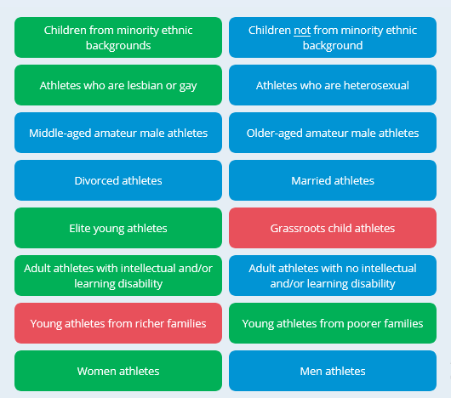

Slide 66
A person’s level of vulnerability can change as circumstances change Someone who is vulnerable one day, might not be vulnerable the next – or someone that has never been particularly vulnerable may have a change in their circumstances that makes them vulnerable.

Slide 67
SIGNS OF ABUSE
Changes in behavior or mood
Unexplained injuries
Withdrawal from teammates or activities
Fear or anxiety around certain individuals

Slide 68
WHY IS SAFEGUARDING IN SPORTS IMPORTANT?
“Safeguarding ensures that athletes & everyone serving SPORTS feel safe, supported and able to perform at their best in a Safe Environment”

Slide 69
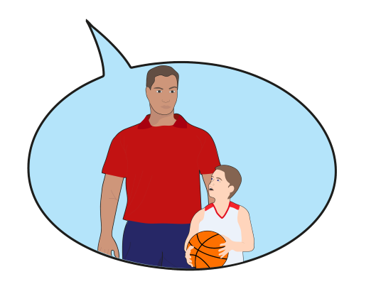
DISCLOSURE
This is when a child or adult tells someone else about an incident or someone who has abused them.
Children are more likely to disclose to someone they know and trust – for example, a parent, a coach, a medic, a friend, or the Safeguarding Lead at their sports club.
You must be clear on some disclosure ‘dos’ and ‘don’ts’ in case you are the person they turn to, so you know how best to manage these situations.

Slide 70
WHY DO CHILDREN RARELY DISCLOSE ABUSE?
It is important to understand why many children do not speak up about abuse:

Slide 71
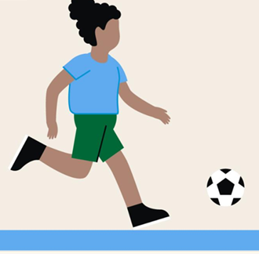
GOOD PRACTICES
Good Practice involves behaviour's that follow the code of conduct and support children's, Athletes wellbeing.
A code of conduct provides guidelines for acceptable and unacceptable behaviours for a sports organisation.
Managers who have significant contact with children, must adhere to strict safeguarding responsibilities.
They should operate in open environments and avoid private interactions with children.

Slide 72
POOR PRACTICES
Behaviours that fall below expected standards (usually set out in a code of conduct)
With Safeguarding Concerns: Actions that jeopardize child safety, such as giving solo rides, inviting children to personal spaces, or grooming (preparing for abuse).
These must be reported and handled according to safeguarding procedures.
Without Safeguarding Concerns: Behaviours that violate the code of conduct but don’t directly impact safety, such as smoking in front of children. These should be addressed by senior managers.

Slide 73
Because peoples’ beliefs and values are different
A framework describing agreed standards of acceptable behavior is needed
Creating codes of conduct can achieve this and help your organization
DEVELOP A GOOD SAFEGUARDING CULTURE

Slide 74
ETHICS AND VALUES – I WILL:
Respect my position of trust and maintain appropriate professional boundaries.
Show respect to others involved in the sport.
Demonstrate high standards of sporting behaviour.
Place the physical and mental wellbeing, safety, and enjoyment of each athlete above everything, including winning.

Slide 75
POSITIVE BEHAVIOURS – I WILL:
Be a positive example and role model for young athletes.
Develop mutual trust and respect.
Respect and value diversity, and challenge and report any form of bullying or abusive behaviour.
Ensure that any time spent with children or vulnerable adults is conducted in an open environment in the presence and visibility of others.
Adhere to the safeguarding policy and report any concerns about poor practice or abuse.
Undertake safeguarding awareness training as required.

Slide 76
UNACCEPTABLE BEHAVIOUR – I WILL NEVER:
Engage in or tolerate any form of bullying.
Reduce anyone to tears, scare, or humiliate them as a form of control.
Engage in, or tolerate, offensive, insulting, or abusive language or behaviour.
Engage in any sexual activity (contact or non-contact) with any child (under 18 years), including making sexually suggestive comments.
Engage in any sexual or intimate relationship with any athlete.
Share a hotel room or other residential bedroom with an athlete.
Share personal details with children, including online or digital information.

Slide 77
Spend time alone with children where my actions cannot be accounted for, including one-on-one engagement via social media or other technological means of communication.
Engage in any physical abuse (including hitting, slapping, shaking, throwing, pushing, or otherwise causing physical harm).
Emotionally or psychologically abuse anyone by shaming or degrading them (including threatening, humiliating, or intimidating).
Support or encourage a child to behave in an aggressive or abusive manner towards others.
Approve comments of a discriminatory nature towards or about any person in our sport.
Perform tasks of a personal nature for a child or person with disability.

Slide 78
GOOD REPORTING MECHANISM?
Developing an effective reporting procedure is an important responsibility for sport organisations
As you have learned, to safeguard everyone, all safeguarding concerns must be reported and addressed.
It is the responsibility of everyone in sport to report concerns.

Slide 79
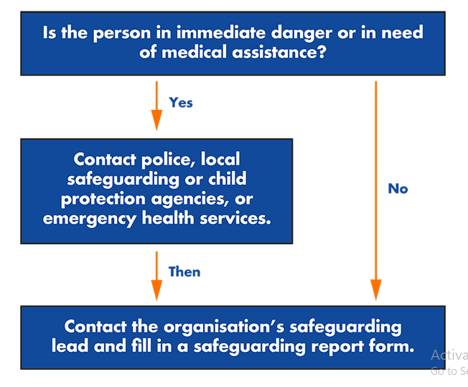
INTRODUCING A REPORTING FLOWCHART

Slide 80

GOOD REPORTING MECHANISM?

Slide 81
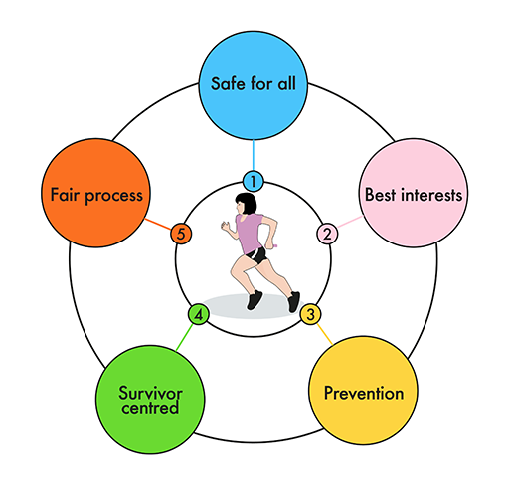
THE KEY PRINCIPLES IN RESPONDING TO CONCERNS

Slide 82

Everyone has the right to participate in sport in a safe and enjoyable environment.
Children’s best interests are the primary consideration in all decisions relating to them.
Preventing abuse, and speaking up about it, is everyone’s responsibility, but responding to concerns confidentially is the responsibility of key individuals.
Case management processes should follow a victim and survivor-centred approach.
Everyone, including those who face safeguarding allegations, have the right to a fair and transparent process

Slide 83
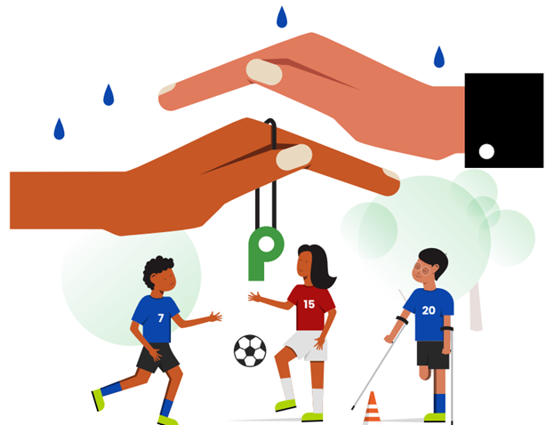
OUR ADVOCACY
WE NEED TO WORK together to develop and promote SAFE sport in Uganda
By implementing robust safeguarding measures
Protect our players from physical, emotional, sexual abuse and Neglect
Create a safe and supportive environment for players to thrive
Enhance reputation of our sports globally
Comply with the standards and best practices
Empower our players to become confident, resilient and successful individuals

Slide 84

OUR ADVOCACY
Safe Guarding is everyone's responsibility.
Stand against Harassment
Say no to all forms abuse
Speak up for safe sport
HELP US TO HELP YOU

Slide 85

OUR ADVOCACY
RECOGNIZE
Any behavior that feels unsafe, causes risk/threat to the
physical and mental wellbeing
RESPOND
Immediately act on the necessary support and play your role
REPORT
UOC Safeguarding is ready to hear your concern and take action.
REACH OUT

Slide 86
REFERENCES
https://passport.world.rugby/safeguarding/safeguarding-essentials/
https://worldathletics.org/athletics-better-world/news/safeguarding-essentials-training-course
(Bellis et al., 2012)
https://safeguardinginfootball.fifa.com/
https://www.unicef.org/

Slide 87
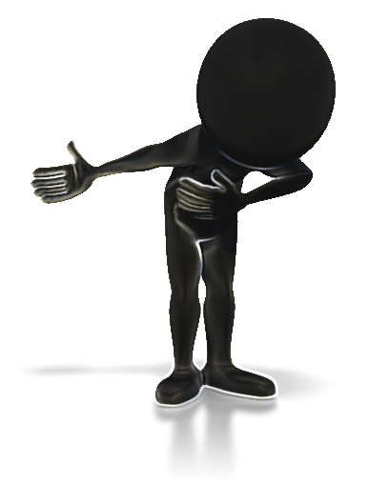

THE END

