Slide 1

Basic and Key Terms for Monitoring and Evaluation
INNOPHINE, ENTEBBE
NOVEMBER 29, 2025
By: DANIEL COMBONI OJARA
M&E SPECIALIST

Slide 2



Presentation Highlights
What is Monitoring
What is Evaluation
What Criteria?
Stages of M&E
Roles and Responsibilities
Questions?

Slide 3
Monitoring (Are we doing the work we planned?)
Integral part of day-to-day management of an activity/ project / programme. It is checking progress
Centered on information with which to identify and solve implementation problems and follow project progress.
Verifies how objectives can be reached
Analyzes changes in the programmatic environment
If needed, corrective action will be undertaken
Actual Achievements
Expected Achievements
Compared with
Deviations from the Plans
Identify
Problems and Opportunities
Identify
Corrective Actions
To follow

Slide 4
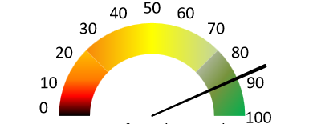
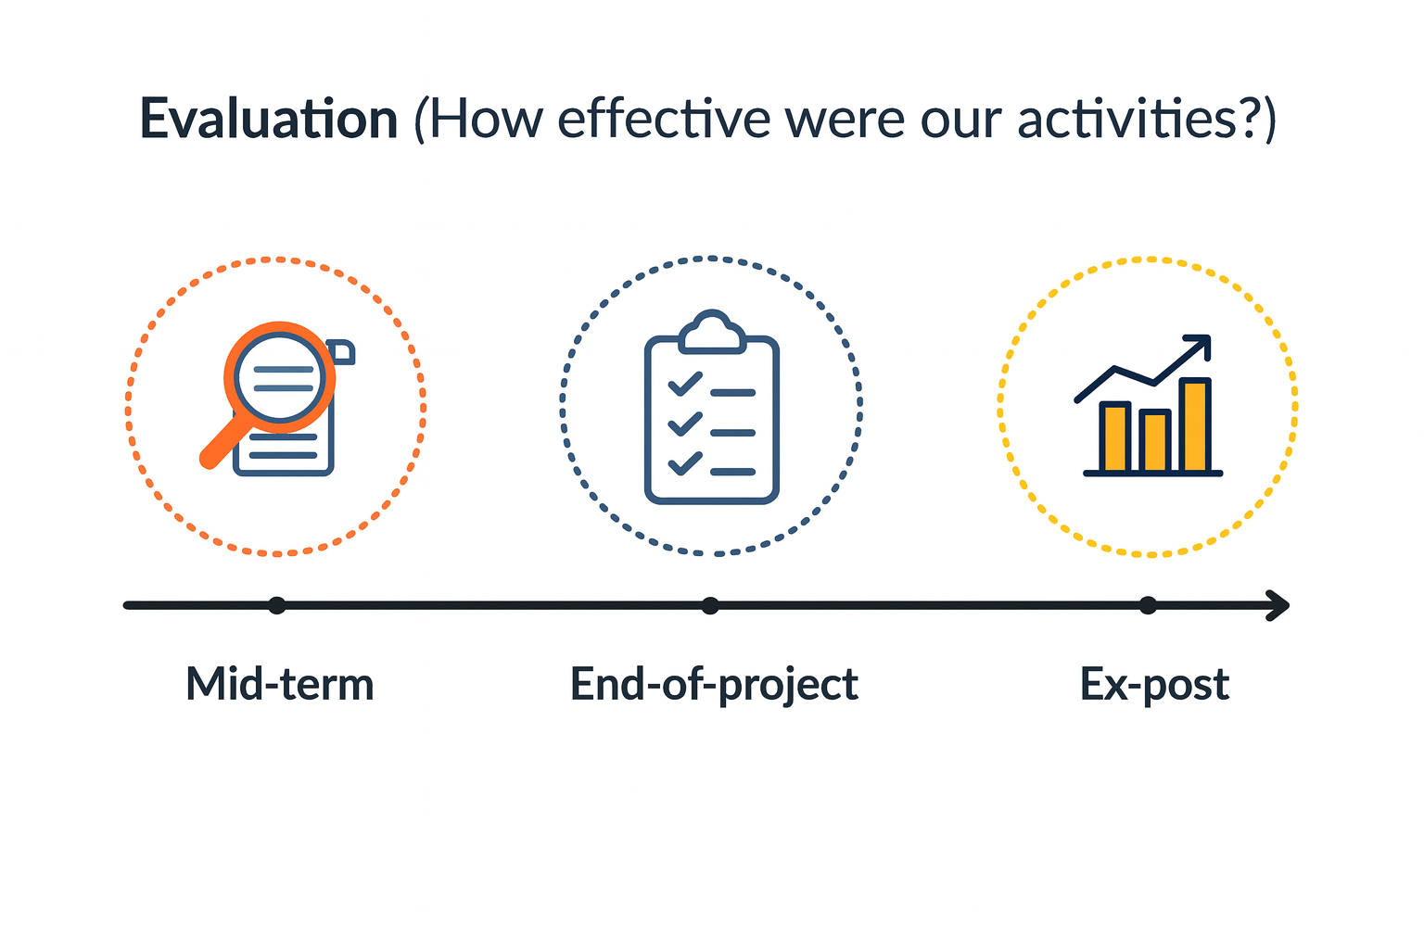
Evaluation (How effective were our activities?)
“Systematic assessment of a project (either ongoing or concluded), of its design, its implementation and its results”.
Evaluation = Measuring performance (Starting Point-Baseline)

Slide 5
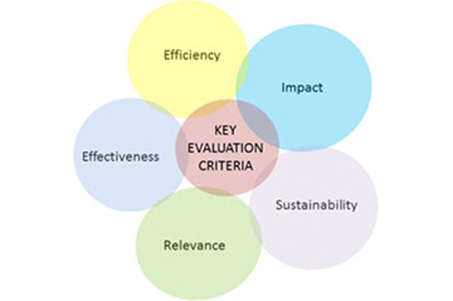
Evaluation Criteria

Slide 6
Stages of M&E
High level objectives to which the project contributes
Overall Objective
/
Goal
Impact
The project’s central objective in terms of sustainable benefit for the target group
Purpose(s)
Specific Objective(s)
Outcome(s)
Effectiveness
The products of undertaken activities
Results
Outputs
Efficiency
Physical and non physical means necessary to carry out activities
Tasks executed as part of project to produce the project’s results
Activities
Means

Slide 7


Our Roles Field Staff in M&E Activities
Activity Data Collection
Tools include attendance, incident logs, Referal forms
Sharing Feedback
Review meetings
Emerging Risks and GBV Concerns
Share insights and learning
Report Referrals
Document and Follow up to completion

Slide 8

Questions and Comments

